Slide 1
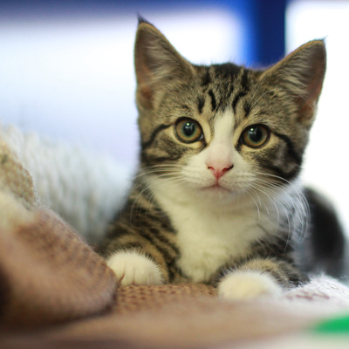
Daily Review
The Binomial (double-name) Naming System
An organism is given a scientific name using the last two levels of its classification (genus and species).
Felis catus
Genus name with capital letter
Species name, no capital letter
Name written in italics (sloping letters)
Vocabulary
bi·no·mi·al (adjective) having or using two names

Slide 2
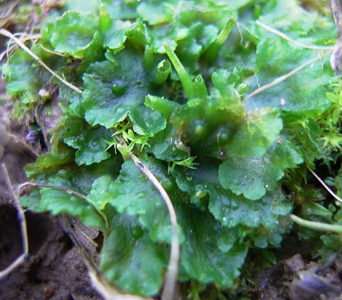
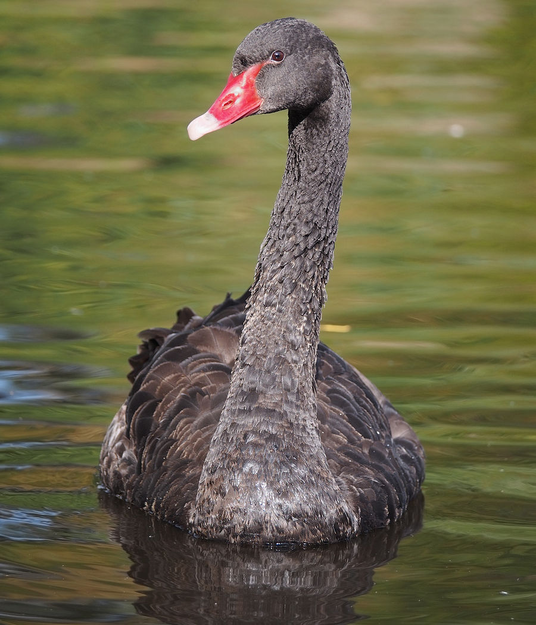
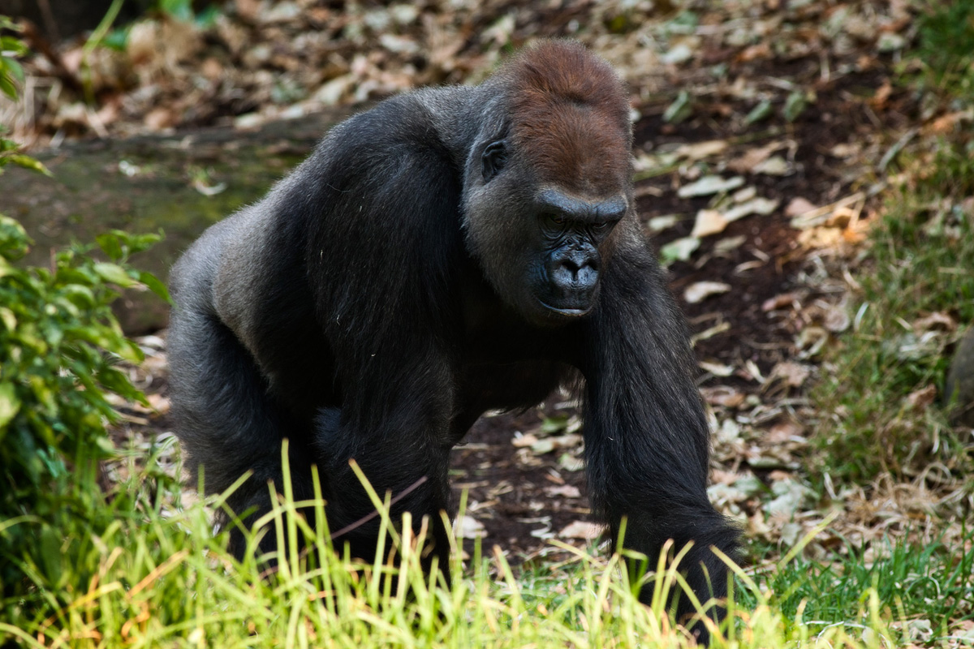
Daily Review
Reminders:
Genus name first with capital letter Species name second with lowercase letter
On your whiteboard, write scientific (binomial) names for the three organisms in the pictures below.
Organism | Smooth hornwort | Black swan | Western gorilla
Kingdom | Plantae | Animalia | Animalia
Phylum | Anthocerotophyta | Chordata | Chordata
Class | Anthocerotopsida | Aves | Mammalia
Order | Notothyladales | Anseriformes | Primates
Family | Notothyladaceae | Anatidae | Hominidae
Genus | Phaeoceros | Cygnus | Gorilla
Species | Laevis | Atratus | Gorilla
Vocabulary
bi·no·mi·al (adjective) having or using two names

Slide 3
Classes of Vertebrates Year 7 Science

Slide 4
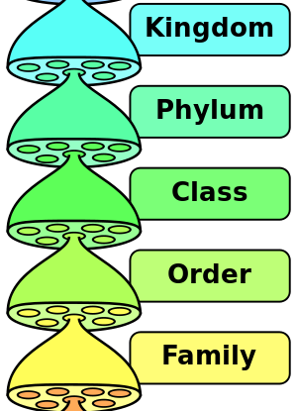
Learning Objectives
CFU
How many classes of vertebrates are there?
Describe the five classes of vertebrates.
Organise this information into a useful form.
Activate Prior Knowledge
Within vertebrates, there are five classes. This makes ‘vertebrates’ a…
Kingdom
Phylum
Order
Family
Vocabulary
ver·te·brate (noun) an animal with a backbone
Notes:
Mention at this point that we’ll take notes later, not as we go

Slide 5
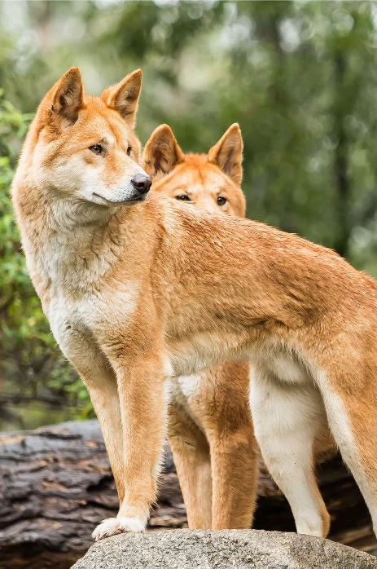
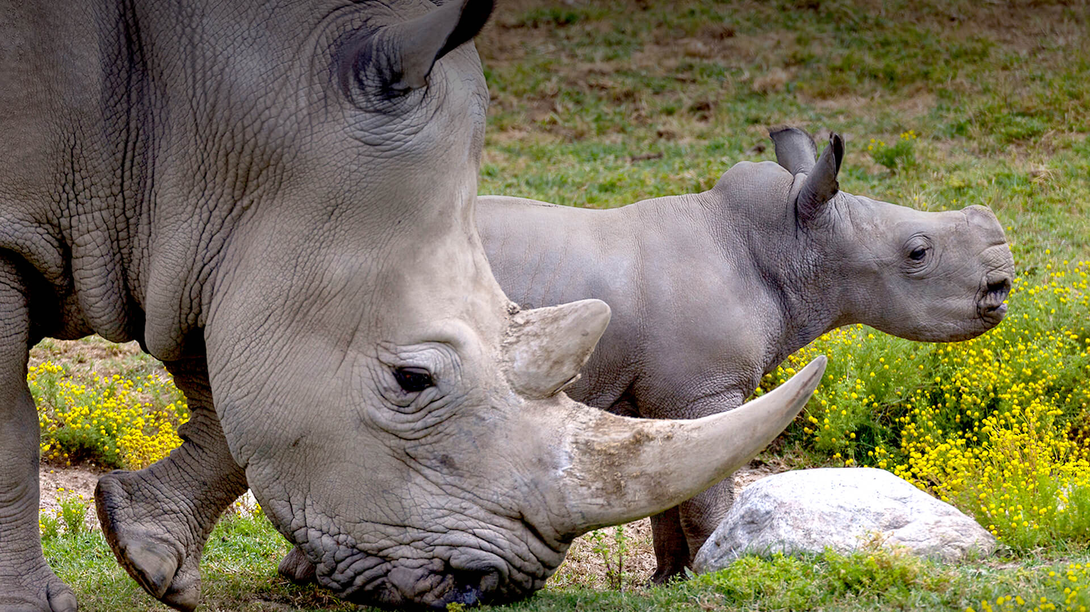
Concept Development
CFU 1
How do mammals feed their young?
Mammalia
Members of the class Mammalia (a.k.a. mammals):
Have hair or fur
Are warm-blooded
Give birth to live young (i.e. they don’t lay eggs)
Produce milk to feed their young
CFU 2
Mammals are warm-blooded. What does this mean?
CFU 3
Carol says that humans are mammals. Is she correct? Why or why not?
Vocabulary
warm-blooded (adj.) able to control the temperature of its body
Notes:
There are two exceptions to the third point (echidna, platypus)

Slide 6
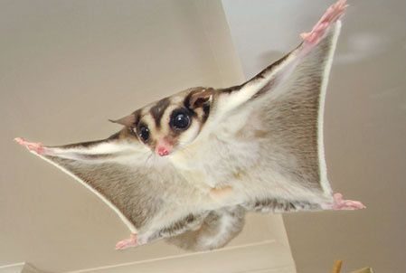
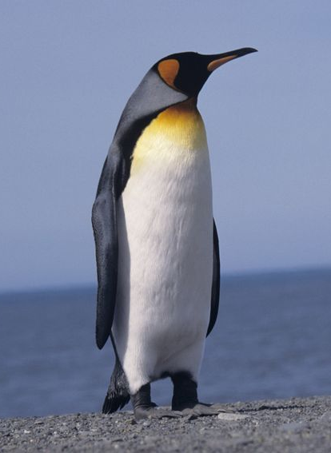
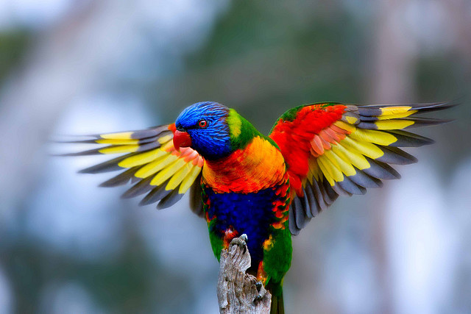
Concept Development
CFU 1
How is the way that birds reproduce different to that of mammals?
Aves
Members of the class Aves (a.k.a. birds):
Have feathers and scaly legs
Are warm-blooded
Lay eggs with hard shells
CFU 2
Jason says that a sugar glider is a bird, because it can fly. Is he correct? Why or why not?
Vocabulary
warm-blooded (adj.) able to control the temperature of its body

Slide 7
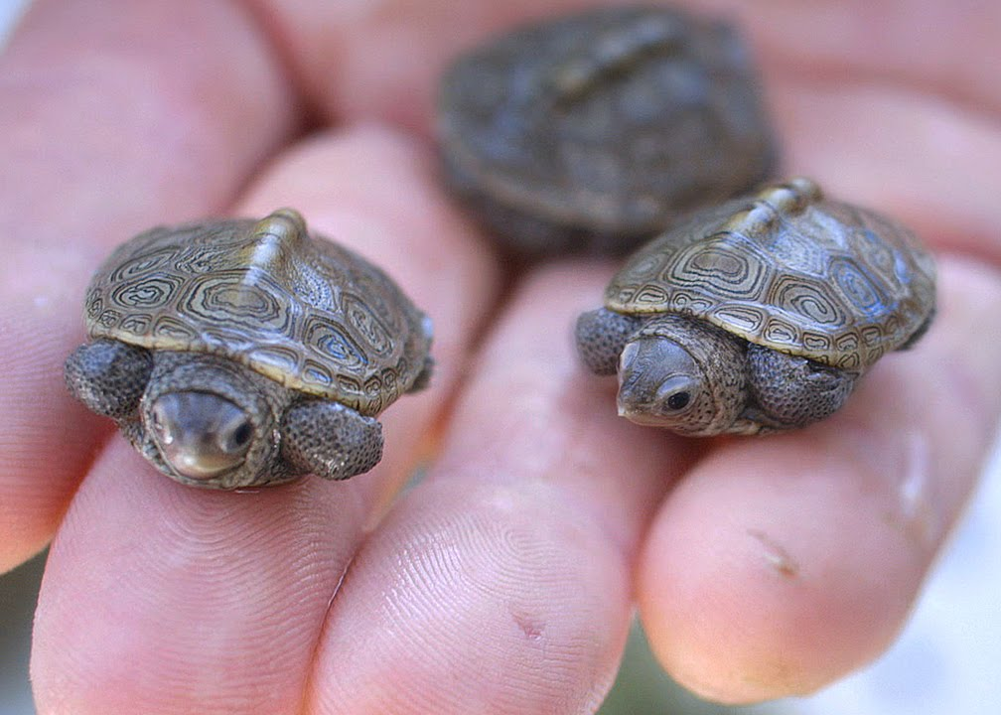
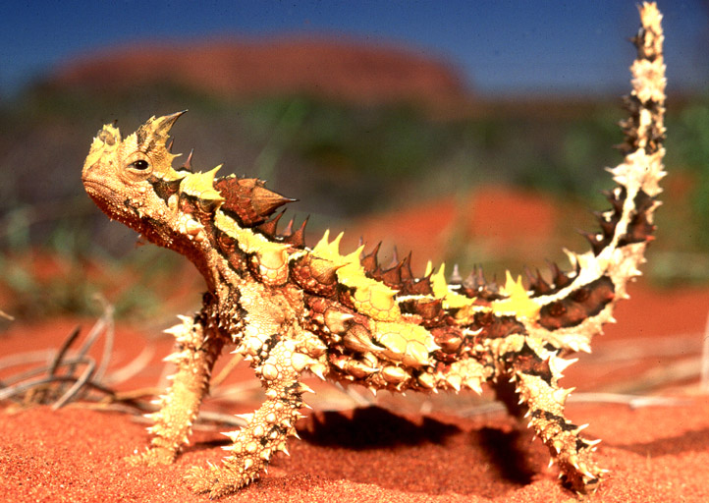
Concept Development
CFU 1
How do reptiles breathe?
Reptilia
Members of the class Reptilia (a.k.a. reptiles):
Have scaly skin
Are cold-blooded
Usually lay eggs
Use lungs to breathe
CFU 2
Reptiles are cold-blooded. What does this mean?
CFU 3
Kate says that goldfish are reptiles because they have scaly skin. Is she correct? Why or why not?
Vocabulary
cold-blooded (adj.) body temperature is decided by the temperature of its environment
Notes:
‘Cold-blooded’ is an informal and somewhat misleading term, since the blood of a reptile that has been lying in the sun would actually be quite warm. ‘Ectotherm’ is the more scientific way to describe an animal that cannot directly control its own body temperature.

Slide 8
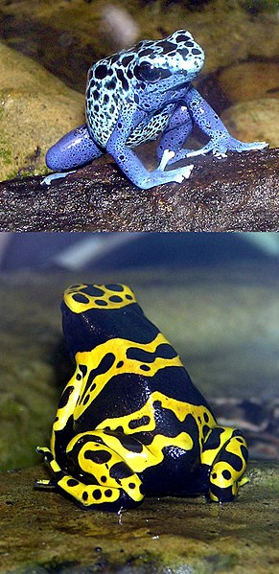
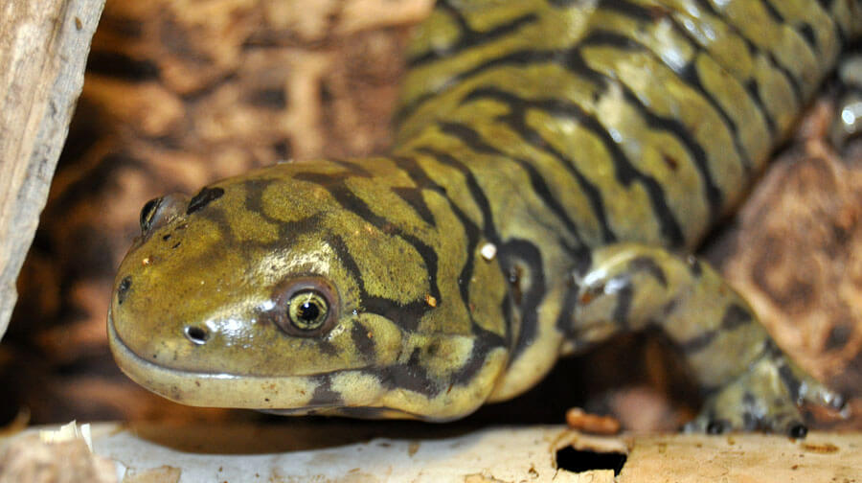
Concept Development
CFU 1
Salamanders are amphibians. What would you expect a salamander to feel like?
Amphibia
Members of the class Amphibia (a.k.a. amphibians):
Have soft, slimy skin
Are cold-blooded
Lay eggs with soft shells
Have gills when young, and lungs as adults
CFU 2
How are a baby amphibian and a fully grown amphibian different?
Vocabulary
cold-blooded (adj.) body temperature is decided by the temperature of its environment
Notes:
L: tiger salamander; R: poison dart frogs

Slide 9
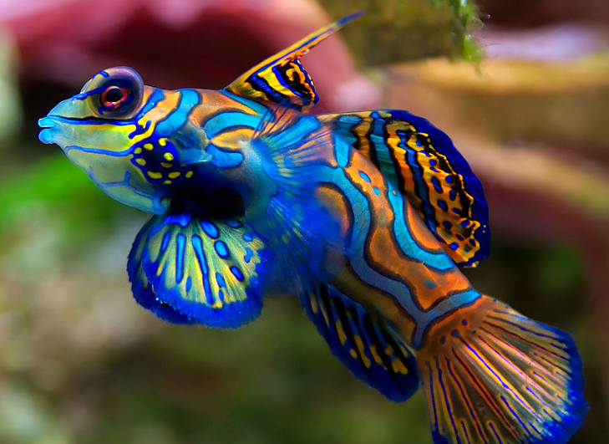
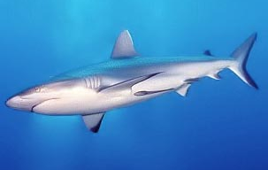
Concept Development
CFU 1
How do fish breathe?
Pisces
Members of the class Pisces (a.k.a. fish):
Have scaly skin
Are usually cold-blooded
Usually have fins
Breathe using gills
CFU 2
Sam says that jellyfish are actually not fish. Is he correct? Why or why not?
Vocabulary
cold-blooded (adj.) body temperature is decided by the temperature of its environment
Notes:
‘Pisces’ is technically an obsolete term.
Fish pictured is a mandarin dragonet (a.k.a. mandarinfish)

Slide 10
Skill Development / Guided Practice
CFU 1
Which words do you need to write down?
We are now going to organise this information and turn it into useful notes.
Get a graphic organiser from your teacher or from Connect.
We are going to go back through the descriptions of each class. You need to write down the bold words in your graphic organiser.

Slide 11
Skill Development / Guided Practice
Mammalia Mammals
Hair or fur Warm-blooded Live young (don’t lay eggs) Produce milk Examples: Dingo Rhinoceros
Mammalia
Members of the class Mammalia (a.k.a. mammals):
Have hair or fur
Are warm-blooded
Give birth to live young (i.e. they don’t lay eggs)
Produce milk to feed their young
Vocabulary
warm-blooded (adj.) able to control the temperature of its body
Notes:
There are two exceptions to the third point (echidna, platypus)

Slide 12
Skill Development / Guided Practice
Aves
Members of the class Aves (a.k.a. birds):
Have feathers and scaly legs
Are warm-blooded
Lay eggs with hard shells
Vocabulary
warm-blooded (adj.) able to control the temperature of its body

Slide 13
Skill Development / Guided Practice
Reptilia
Members of the class Reptilia (a.k.a. reptiles):
Have scaly skin
Are cold-blooded
Usually lay eggs
Use lungs to breathe
Vocabulary
cold-blooded (adj.) body temperature is decided by the temperature of its environment
Notes:
‘Cold-blooded’ is an informal and somewhat misleading term, since the blood of a reptile that has been lying in the sun would actually be quite warm. ‘Ectotherm’ is the more scientific way to describe an animal that cannot directly control its own body temperature.

Slide 14
Skill Development / Guided Practice
Amphibia
Members of the class Amphibia (a.k.a. amphibians):
Have soft, slimy skin
Are cold-blooded
Lay eggs with soft shells
Have gills when young, and lungs as adults
Vocabulary
cold-blooded (adj.) body temperature is decided by the temperature of its environment
Notes:
L: tiger salamander; R: poison dart frogs

Slide 15
Skill Development / Guided Practice
Pisces
Members of the class Pisces (a.k.a. fish):
Have scaly skin
Are usually cold-blooded
Usually have fins
Breathe using gills
Vocabulary
cold-blooded (adj.) body temperature is decided by the temperature of its environment
Notes:
‘Pisces’ is technically an obsolete term.
Fish pictured is a mandarin dragonet (a.k.a. mandarinfish)

Slide 16
Relevance
Knowing about classes helps you when you’re learning about a new animal: if you know its class, you already know a lot about it.
Chordata contains some of the most widely loved animals in the world. Unfortunately, many of them are at risk of extinction: 25% of mammals and 41% of amphibians are threatened or endangered!

Slide 17
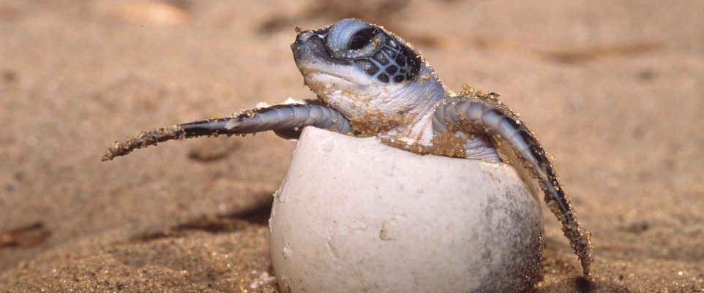
Skill Closure
What is one characteristic of mammals that no other class has?
Skill Closure
Which classes lay eggs? How are the eggs of each class different?
Skill Closure
What do organisms in Reptilia, Amphibia and Pisces all have in common?
Skill Closure
What class does a turtle belong to? Explain your choice.

Slide 18
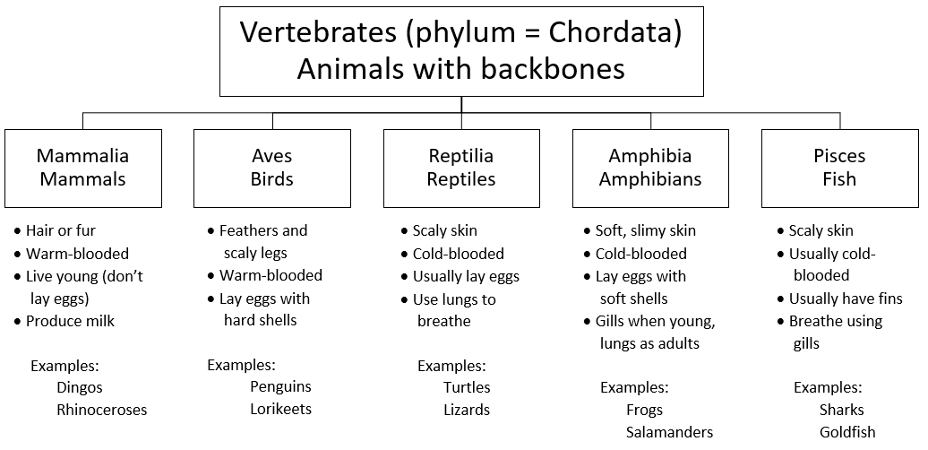
Independent Practice
Complete questions 1-3 and 6 on page 93 of your textbook.

